Slide 1
BOOTCAMP JOURNEY
By: Anushka Patel
655084

Slide 2
WEEK 1 14th August – 18th August
BUSINESS ANALYSIS & AGILE

Slide 3
BUSINESS ANALYSIS & AGILE – Day 04
Business Analysis & Role of an Analyst
SDLC: Software development life cycle process.
Steps in SDLC:
Waterfall Model VS Agile Model
Agile Model Practices
Terminologies Used In Agile:
Various group activities to understand role of business analysis and stakeholders, hands on and case studies.
Requirement Analysis
Planning
Designing
Development
Testing
Deployment
Maintenance
Sprint
Scrum
Scrum Master
Product Owner

Slide 4
WEEK 2 21st August – 25th August
BUSINESS ANALYSIS & AGILE
DBMS
SOFTWARE TESTING
CLOUD
DEVOPS

Slide 5
BUSINESS ANALYSIS & AGILE – Day 01
Introduction to Epic, User Story, Task, Sub Task
How To Create Story Points
DOR (Definition of Ready) & DOD (Definition of Done)
Sprint Board
Scrum Fundamentals
Various Reports:
Real Time Examples
Estimation
Various group activities to understand role of business analysis and stakeholders, hands on and case studies.
Burndown Chart
Burnup Chart
Velocity Chart

Slide 6
DBMS – Day 02
SQL Introduction
Normalization:
Joins:
Fetching Data From Multiple Tables
Self Reference
Sub Queries
Usage of AVG, MAX, MIN, HAVING, ORDER BY, GROUP BY, IN BETWEEN, etc.
1NF
2NF
3NF
BCNF
4NF
5NF
Inner Join
Outer Join
Right, Left Outer Join
Cross Join
Natural Join

Slide 7
SOFTWARE TESTING – Day 03
STLC: Software testing life cycle process.
Steps in STLC:
Manual Testing
Automation Testing
Types of Testing:
Test Case Desing
Test Strategy
Test Planning
Test Design
Test Environment
Test Execution
Defect Reporting
Test Closure
Unit Testing
Integration Testing
System Integration Testing
System Testing

Slide 8
CLOUD – Day 04
Cloud Computing & Its Architecture & Characterstics
Cloud Models:
Microsoft Azure & AWS Overview
Virtualization & Virtual Machines
Containers (Light weight VMs)
Creating Virtual Machine on Azure Platform
Cloud Computing Service Layers
SaaS (Software as a Service)
FaaS (Function as a Service)
PaaS (Platform as a Service)
CaaS (Container as a Service)
IaaS (Infrastructure as a Service)

Slide 9
DEVOPS – Day 05
Introduction to CD (Continuous Delivery):
Introduction to CI (Continuous Integration):
Monolithic Architecture (Tightly Coupled)
Loosely Coupled Architecture
Microservice Architecture
Hands on training on how to create a VM on Microsoft Azure.
Hands on training on Github Actions, workflow.
Infra as Code: YAML Scripting
EX: Terraform
Config Management: Installing app on infra
Ex: Ansible, Chef, Puppet
Jenkins
Github Actions

Slide 10
WEEK 3 28th August – 1st September
CASE STUDY
DBMS
Schema, Datawarehouse Structure, SCD, BIG DATA
SQL ON AZURE
SQL ON AZURE

Slide 11
CASE STUDY – Day 01
Create a Virtual Machine on Azure.
Run commands on Azure Virtual Machine.
Setting up the docker repository.
Installing docker engine.
Downloading latest DEB package.
Launching docker desktop.
Cloning the application to our local development machine.
Creating dockerfile for java.
Creating .dockerignore file.
Building first docker image.
Creating a repository on docker hub.
Create Azure Web App
GitHub Actions

Slide 12
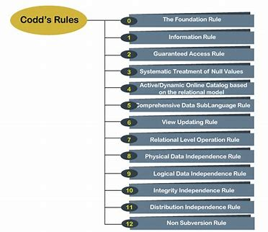
DATABASE MANAGEMENT SYSTEM – Day 02
ER Model
Types of Attributes
Key
Composite
Multivalued
Derived
Types of relationships in DBMS
One-to-One
One-to-Many
Many-to-One
Many-to-Many

Slide 13
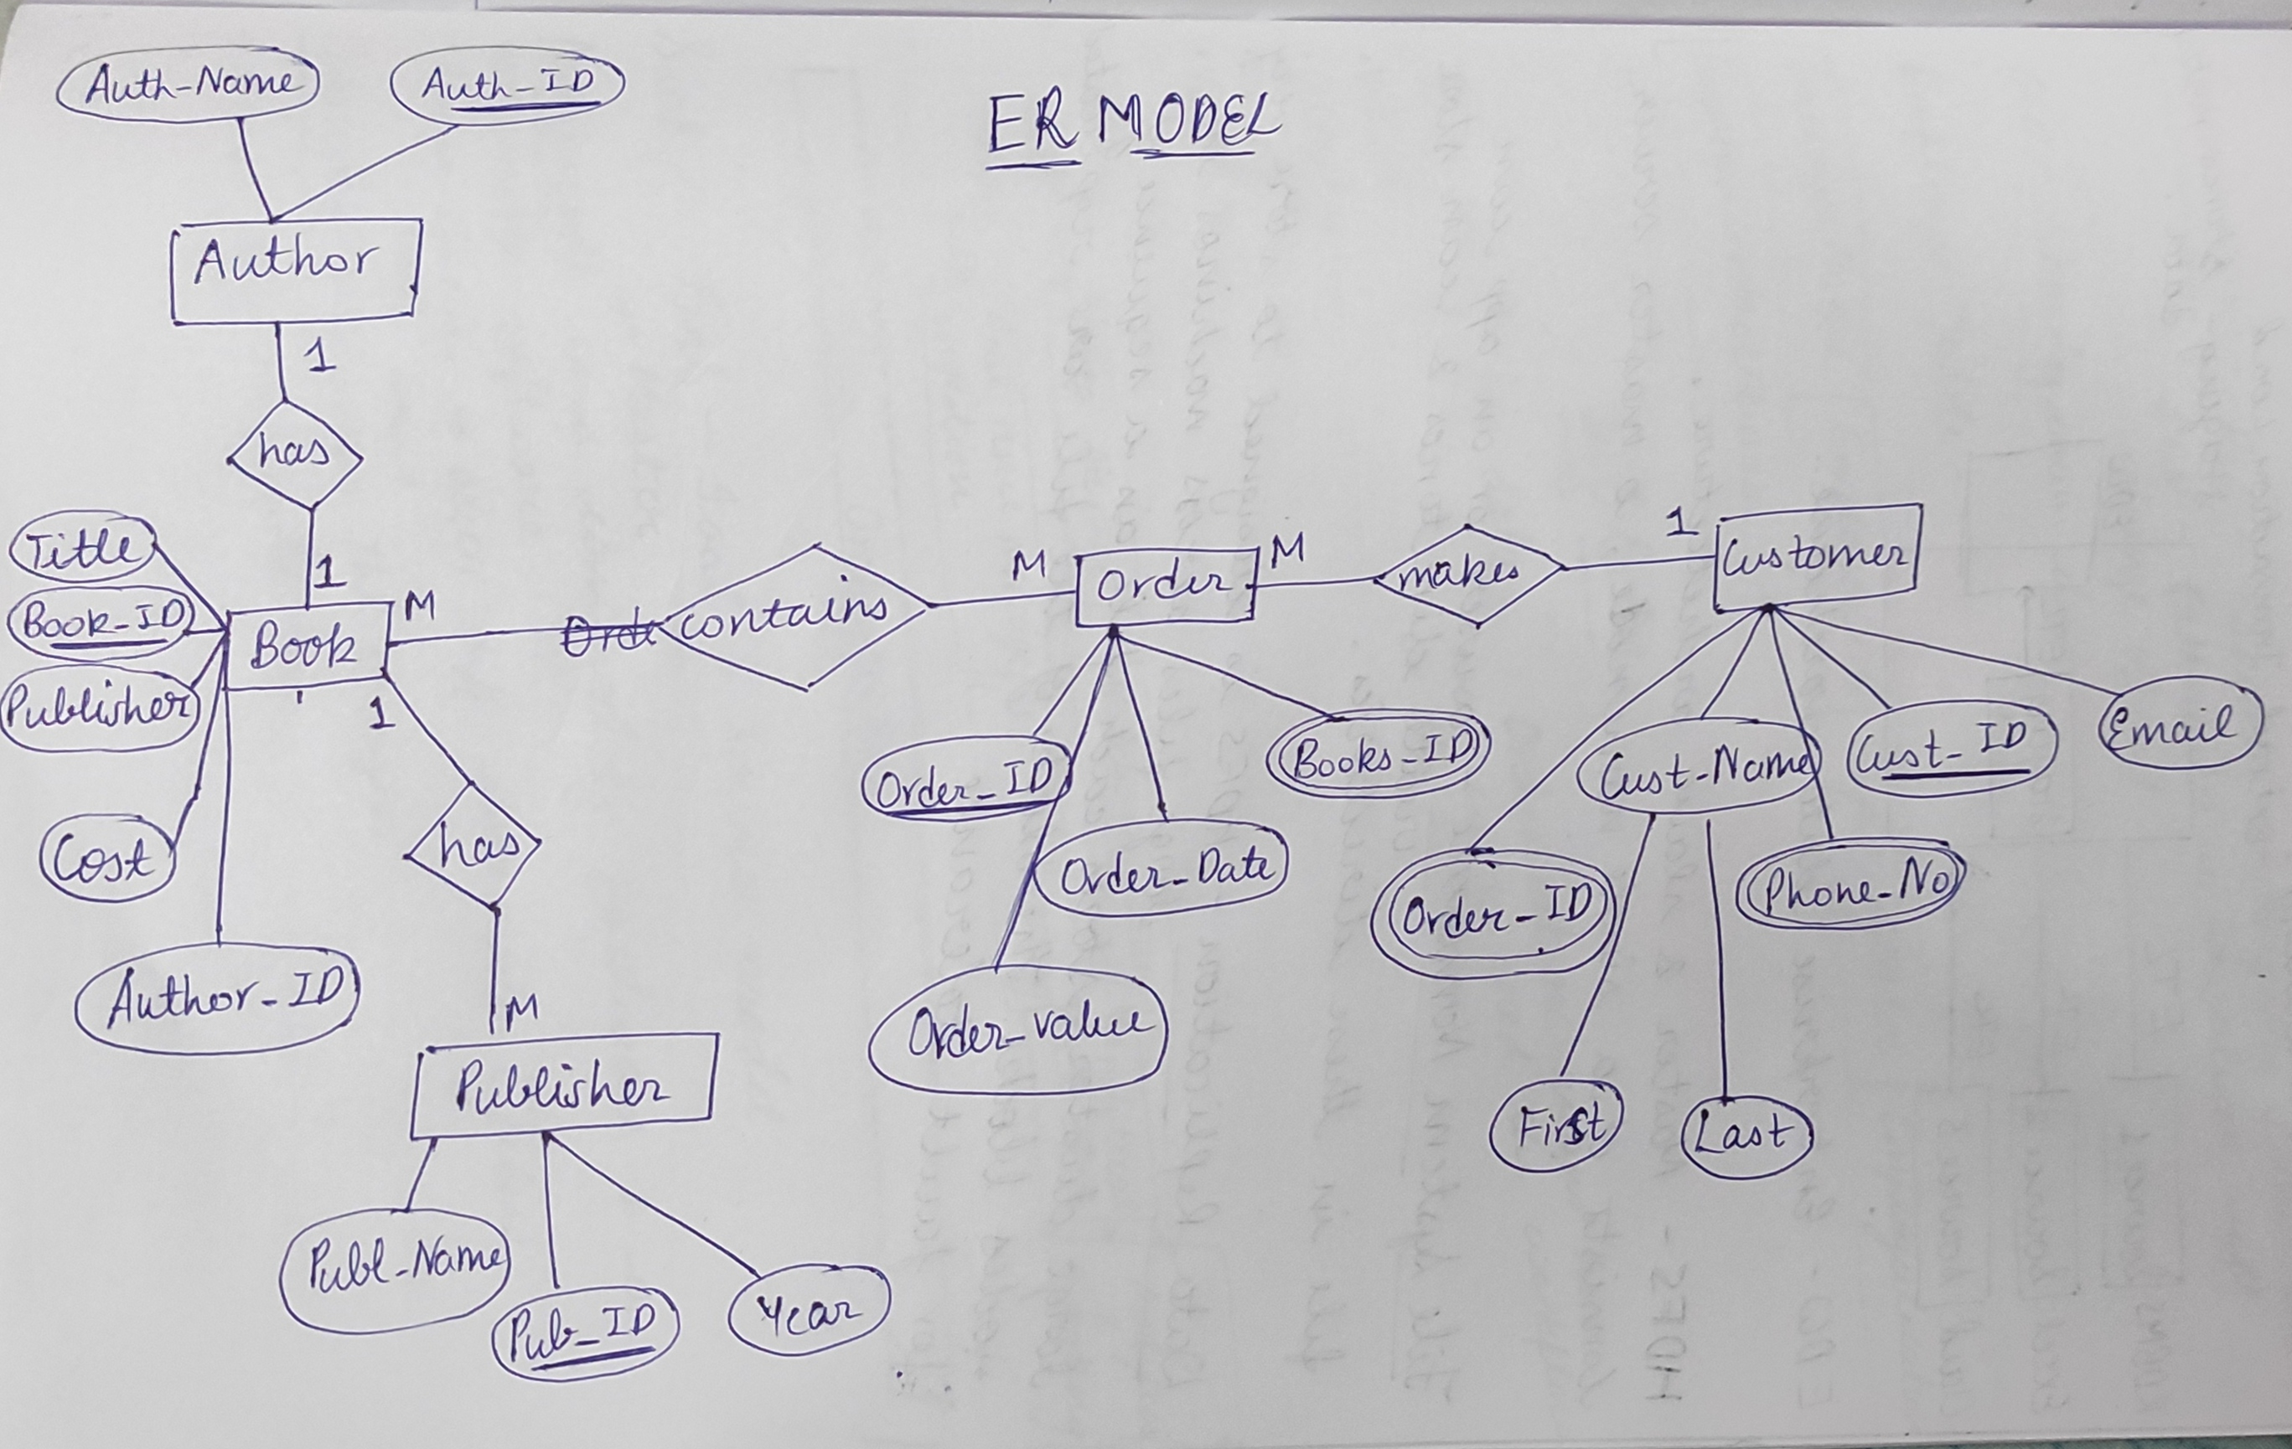
DATABASE MANAGEMENT SYSTEM – Day 02
Normalization - process of reorganizing data within a Database so that users can utilize it for further queries and analysis.
1NF
2NF
3NF

Slide 14
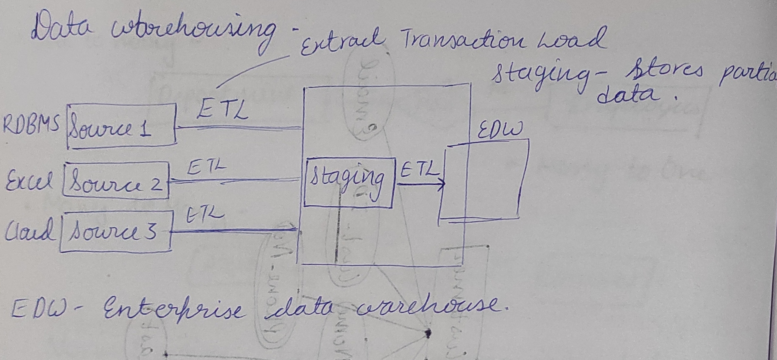
Schema, Datawarehouse Structure, SCD, BIG DATA - – Day 03
Star Schema v/s Snowflake
Dimensions
RCD (Rapidly Changing Dimension)
SCD (Slowly Changing Dimension)
SCD1
SCD2
SCD3

Slide 15
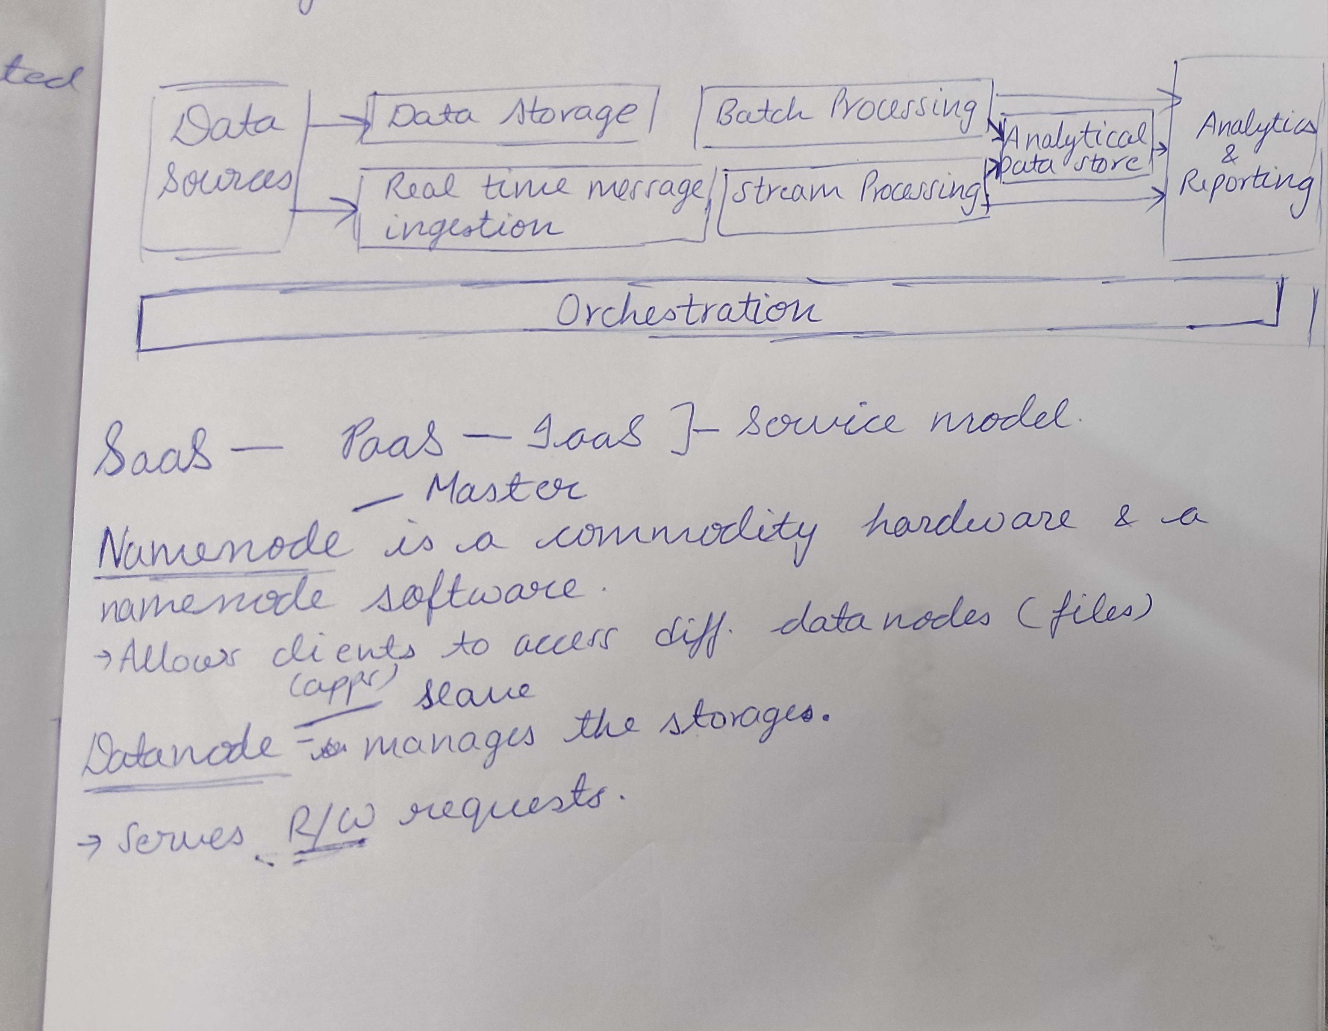
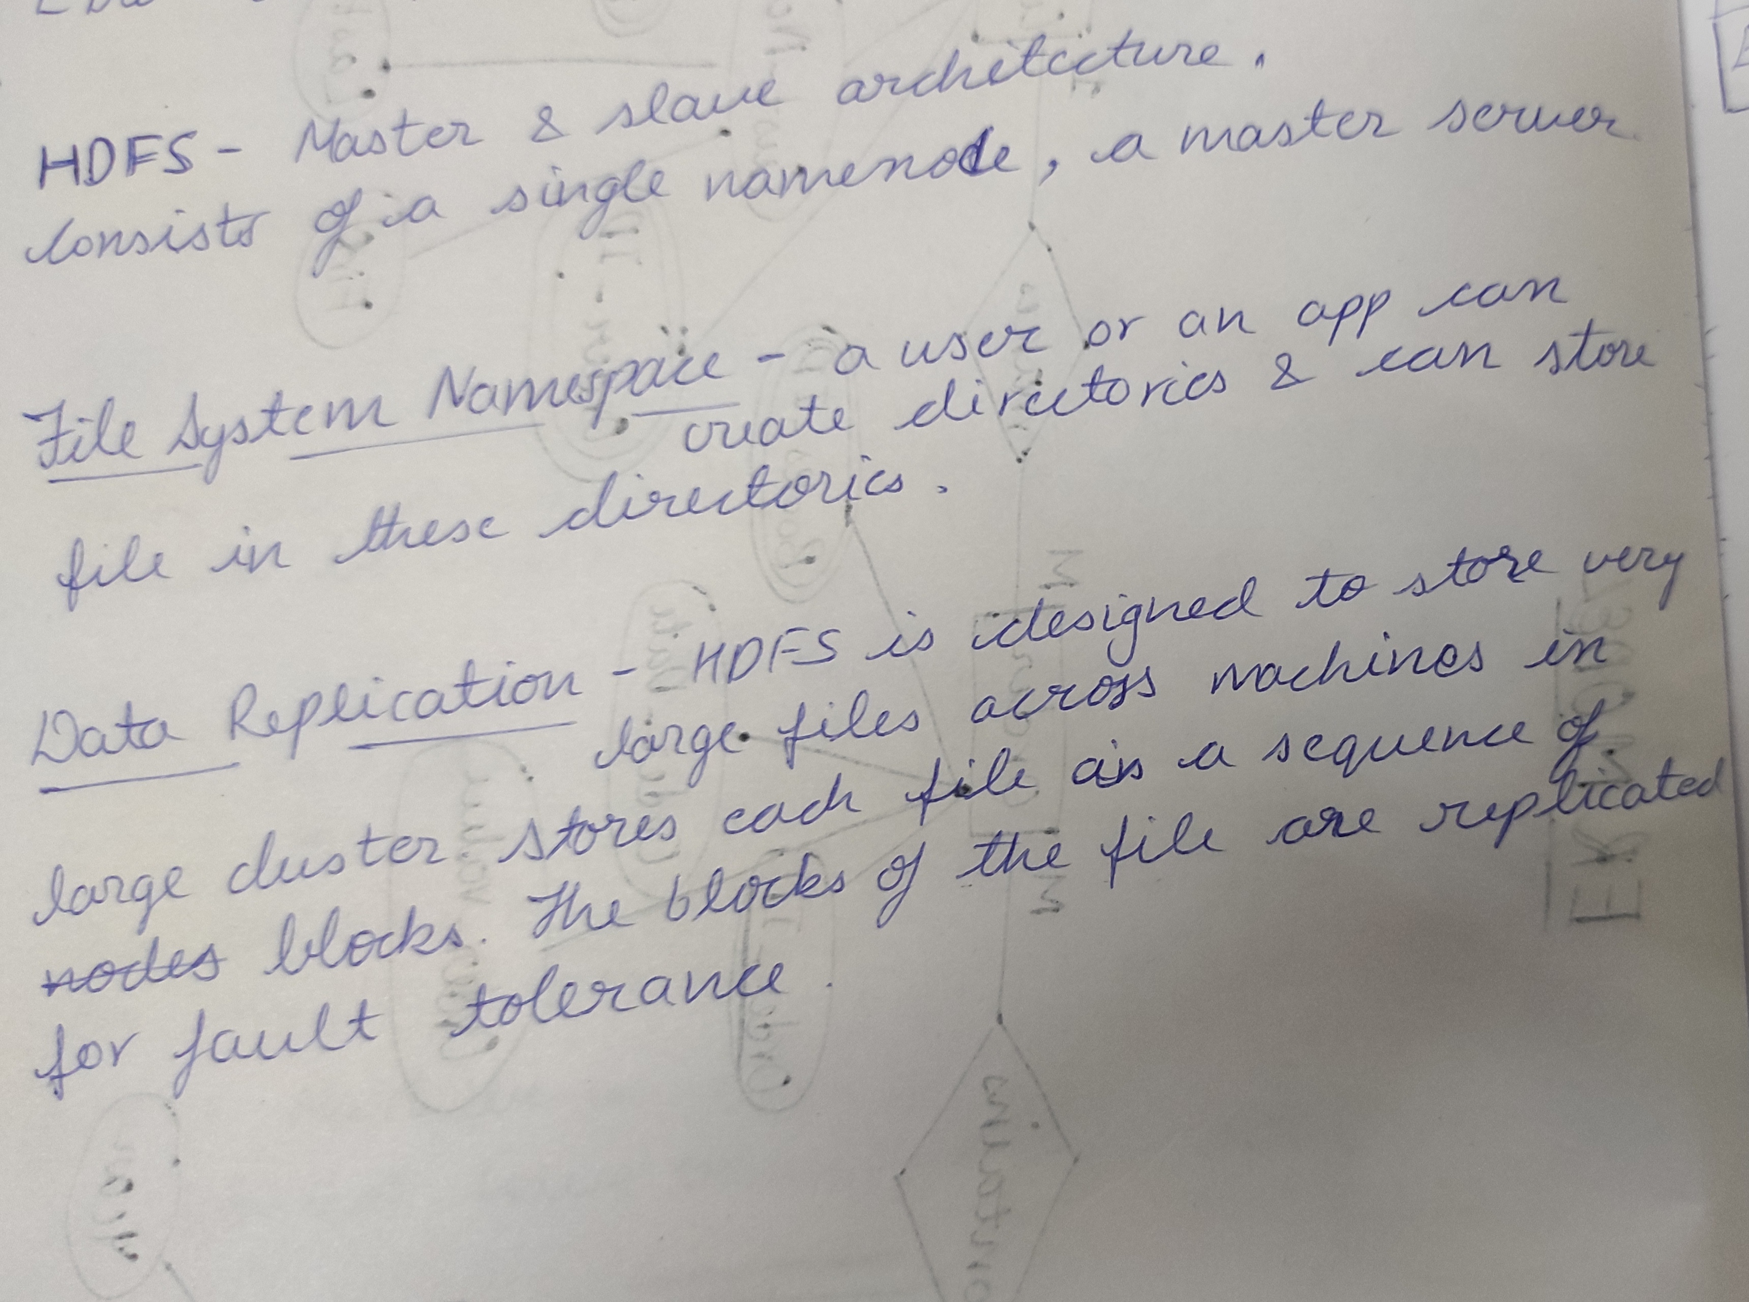
Schema, Datawarehouse Structure, SCD, BIG DATA – Day 03
BIG DATA – Four Vs :
Volume
Velocity
Variety
Veracity
Service Model – IAAS,PAAS,SAAS
HDFS Architecture – master-slave architecture

Slide 16
AZURE SQL – Day 04
Practiced following on Azure SQL:
Creation of the main Source Table
Creation of the SCD1 Table: overwrites old with new data, therefore does not track history
Creation of the SCD2 Table: tracks historical data by creating multiple records
Creation of the SCD3 Table: tracks changes using separate columns and preserves limited history

Slide 17
AZURE SQL – Day 05
Practiced on Azure SQL:
Joins –
Union
Union All
Intersection
Subqueries
Stored Procedure
Functions
Views
Inner Join
Left Outer Join
Right Outer Join
Full Outer Join
Heaps
Clustered Indexes
Non Clustered Indexes
Columnstore Indexes
Indexes -

Slide 18
WEEK 4 4th September – 8th September
AZURE DATA STORAGE
AZURE DATA STORAGE
AZURE DATA FACTORY: CONTROL FLOW ACTIVITIES
AZURE DATA FACTORY: DATA FLOW ACTIVITIES
HANDS ON ACTIVITY, CASE STUDY, CHANGE DATA CAPTURE

Slide 19
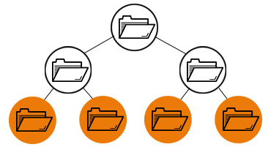
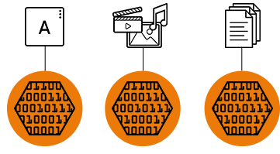
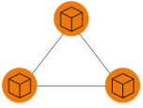
AZURE DATA STORAGE: Day 01
Types of Storage:
Access Tier:
Azure Storage Services:
Azure Data Link Storage Gen 2
Storage Hierarchy:
Publishing Static Website on azure
File storage
Block Storage
Object Storage
File Storage
Hot Tier
Cool Tier
Cold Tier
Archive Tier
Queue
Table
Blob
File
Block Storage
Object Storage
Blob: Unstructured Data (documents, images, videos)
Data Lake: Structured Data (log files, orc, big data)

Slide 20
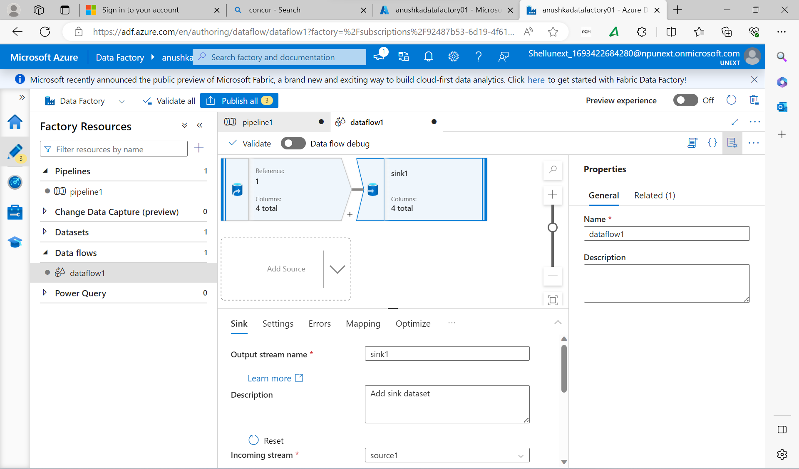
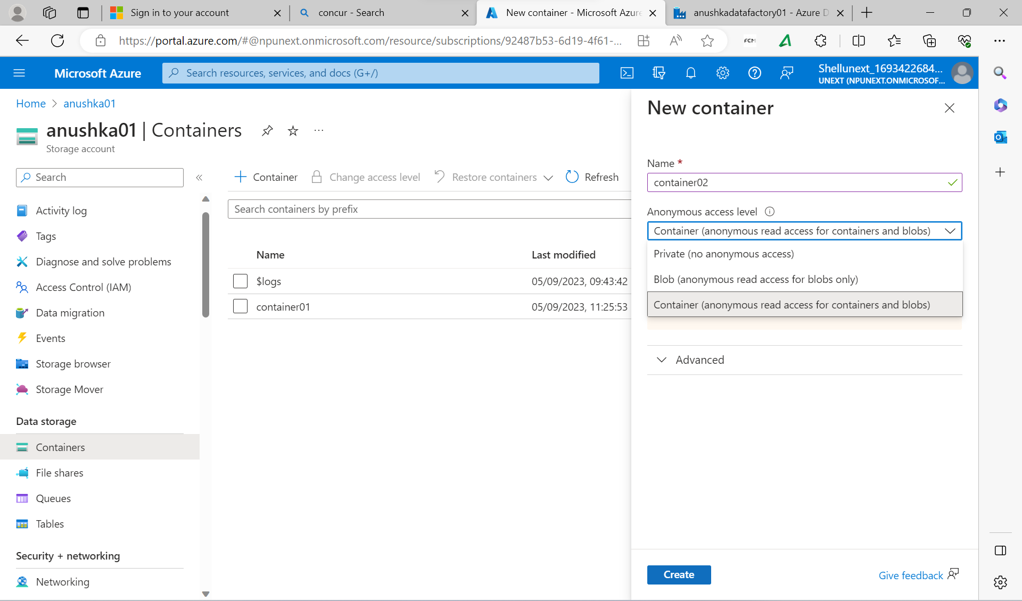
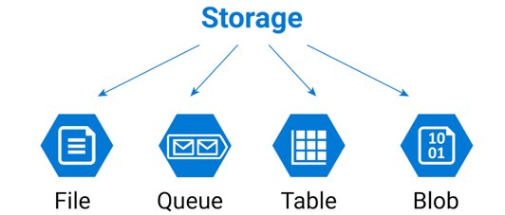
AZURE DATA STORAGE: Day 02
LRS
ZRS
GRS
GZRS
Azure Storage Account Using:
Azure File Share, Queues, Tables
ETL Vs ELT
Azure Data Factory: Data Flow Creation
Creation of Storage Account & Containers

Slide 21
AZURE DATA FACTORY: Day 03
If Condition Activity
For Each Activity
Filter Activity
Variable Activity
Until Activity
Web Activity
Data Control Flow Activities:

Slide 22
AZURE DATA FACTORY ACTIVITIES: Day 04
Switch Activity
Wait Activity
Control Flow Activities:
Control Flow Activities Vs Data Flow Activities
Data Flow Activities:
Select Transformation
Conditional Split Transformation
Derived Column Transformation
Union Transformation
Sort Transformation
Filter Transformation
Aggregate Transformation
Join Transformation
Lookup Transformation
REST API Transformation

Slide 23
AZURE DATA FACTORY ACTIVITIES: Day 05
Lookup Activity
Script Activity
Stored Procedure Activity
Control Flow Activities:
Case Study: Create a Storage Account and Container in your Azure account. I have a Folder in the Storage Account. Inside I have three csv files. So, I need to copy all the files dynamically into another folder (A new folder you need to create). If I add one more file to my folder, it should automatically copy into the other folder.
Hands On Activities

Slide 24
WEEK 5 12th September – 15th September
AZURE SYNAPSE
POWER BI
POWER BI
HANDS ON ASSIGNMENT & PYTHON

Slide 25
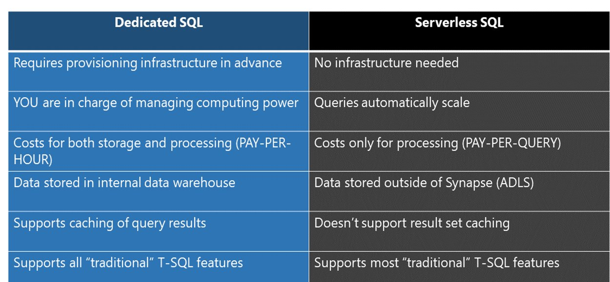
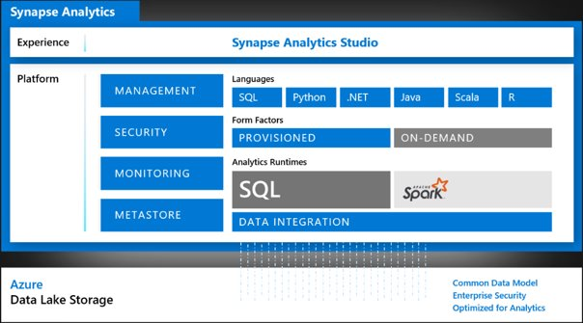
AZURE SYNAPSE: Day 01
Creation Of Azure Synapse
Serverless SQL Pool
Dedicated SQL Pool
Difference between serverless vs dedicated pool

Slide 26
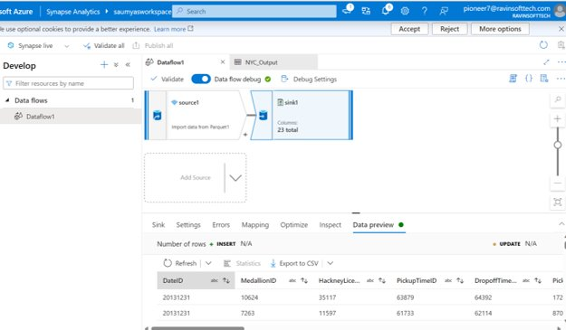
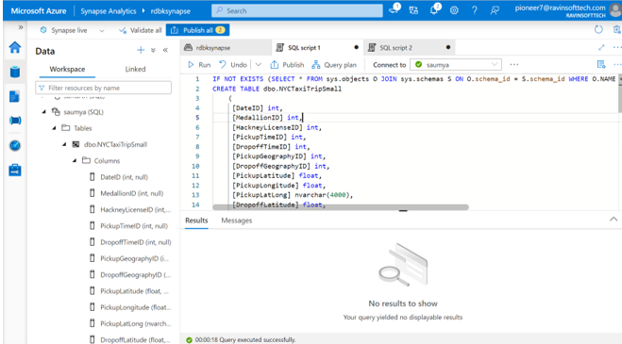
AZURE SYNAPSE: Day 01

Slide 27
POWER BI: Day 02
Introduction to Power BI
Power Query
Data transformation & data preparation.
Managing Relationships
Power Pivot
Power View: Different visualizations included.
Power Map
Data Sources in Power BI (72)
Different Tabs
Dashboard
M Language: Transformation of data (power query) in the backend uses this language.
Dashboard
M Language: Transformation of data (power query) in the backend uses this language.
DAX: Data Analysis Expression.
Calculated Columns
Measure

Slide 28
POWER BI: Day 03
Hands On Assignment: BOOTCAMP/PowerBI/demo1.pbix at main · Anushka09-12/BOOTCAMP (github.com)
Hierarchy Creation
Creation of Dashboard
Drill Up, Drill Down, Expand All, Go to Next Level
RLS (Row Level Security): restricts the data from the users based on the rows assigned to them.

Slide 29
HANDS ON & PYTHON: Day 04
Hands On Assignment On Power BI: BOOTCAMP/Hands On Assignment Power BI.docx at main · Anushka09-12/BOOTCAMP (github.com)
Python Introduction
Data Types:
Operators:
String Formatting
Conditional Statements and Control Flow
Zip Function
Int
Float
String
Bool
Complex
Arithmetic
Relational
Logical
Membership

Slide 30
HANDS ON & PYTHON: Day 04
Tuples
List
Closed inside the parenthesis().
Heterogenous objects are allowed.
Duplicates are allowed.
Indexing and slicing is possible.
Immutable
Order is preserved.
Closed inside the [] brackets.
Heterogenous objects are allowed.
Duplicates are allowed.
Indexing and slicing is possible.
Mutable
Order is preserved.
Dictionary
Closed inside the {} brackets.
Heterogenous objects are allowed.
Duplicate keys are not allowed but duplicate values can be there.
Indexing and slicing is possible.
Mutable
Order is preserved.
Set
Closed inside the {} brackets.
Heterogenous objects are allowed.
Duplicates are not allowed.
Mutable
Order is not preserved (Unordered).

Slide 31
WEEK 6 19th September – 22nd September
PYTHON
PYTHON
PySPARK
PySPARK

Slide 32
PYTHON: Day 01
Functions in Python
Types of Functions:
Types of Arguments in a Function:
List Comprehension
List Functions (map & filter)
Introduction to Classes & Objects
Github Link
Parameterised Functions
Recursive Functions
Generator Functions
Decorator Functions
Positional Arguments
Keyword Arguments
Default Arguments
Variable Length Arguments
Keyword Variable Length Arguments

Slide 33
PYTHON: Day 02
Libraries in Python
Pandas
Numpy
Matplotlib
Hands on Exercise
Github Links:
Pandas Exercise
Numpy Exercise
Matplotlib Exercise
Hands on

Slide 34
PySPARK: Day 03
Reading & Writing CSV Files
PySpark SQL:
Github Link
Introduction to PySpark
Why We Shifted From Hadoop To Spark
Components of PySpark
Spark Architecture
Application & Use Cases Of Apache Spark
Spark Deployment Modes
Creation of:
Select()
Option()
Col()
Column()
Lit()
Concat()
PySpark Session
PySpark Context
RDD
Data Frames

Slide 35
PySPARK: Day 04
Why we need to define schema instead of inferschema?
Data Types in PySpark:
Creation of Schema Using Struct Data Type of PySpark
Usage of explode() Function
Reading & Writing JSON Files
Saving Files in Form of Tables
Modes of Writing: Overwrite & Append
Graph Plotting of The Data Frame Using Matplotlib
Github Link
When header is not available
When we have a large dataset
Struct
Array
Map

Slide 36
WEEK 7 25th September – 29th September
PySpark
Databricks
Databricks
Azure Containers
Azure Deployment/DevOps

Slide 37
PySpark: Day 01
Null Handling
Partition of Your Dataset Using: partitionBy()
Usage of:
Github Link
filter()
desc_nulls_last , asec_nulls_last
dropna() , na.drop()
fillna() , na.fill()
replace()
Subset
maxRecordsPerFile

Slide 38
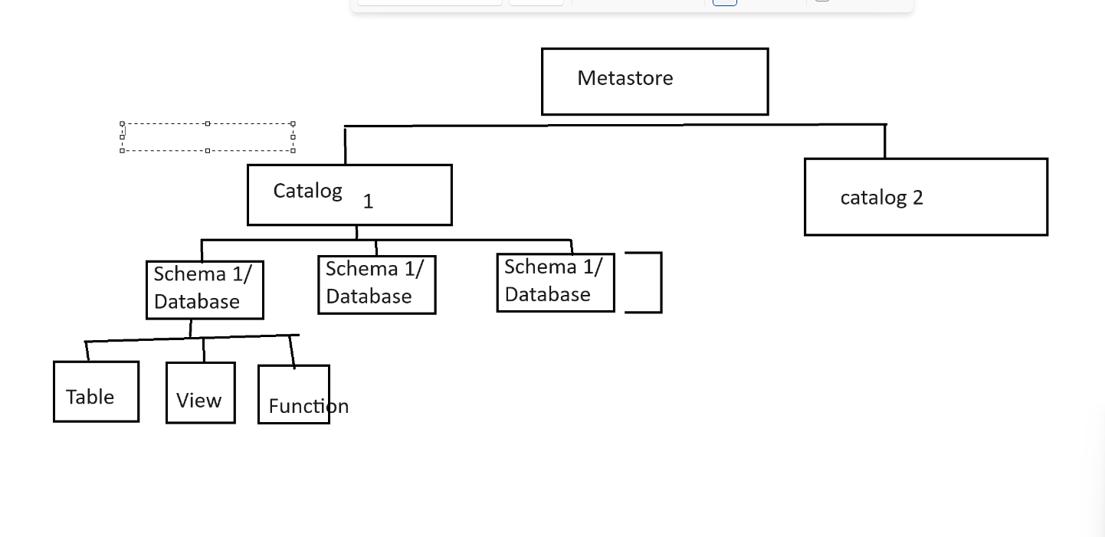
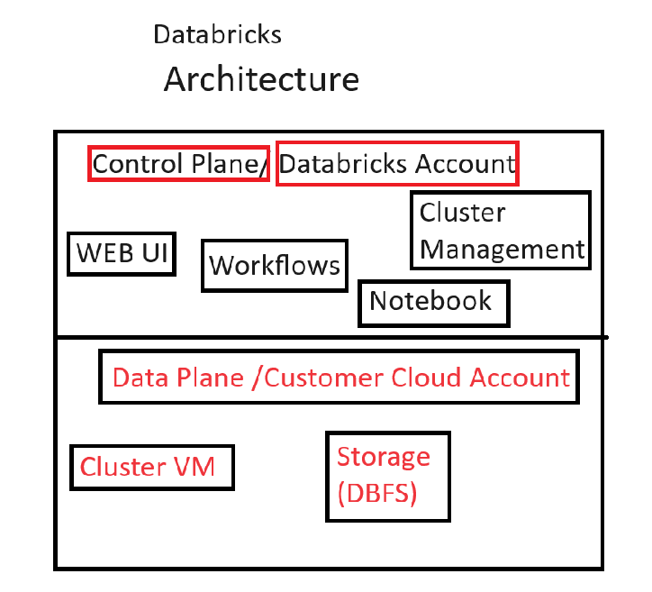
Databricks: Day 02
Databricks Architecture
High Level Architecture
Introduction to Azure Databricks
Notebook Creation in Databricks
Cluster Creation
Creation of Data Frames in Databricks Notebook
Read or Write Files to Data Lake
Connect Databricks to Data Lake (Mounting):
Streaming
Github Link
Using Access Keys
Using SAS
Using Service Principle

Slide 39
Databricks: Day 03
Multi Hop Architecture (Bronze Silver Gold Architecture)
Lakehouse: Combination of Data Lake & Data Warehouse
Delta Format: This Format is Used For Storing Data in Lakehouse
Features of Data Lakehouse
CTAS Statements
Widget Creation
Versions & History of Datasets
Github Link
Source
ADF
Blob
Synapse
Report
Source
ADF
Data Lakehouse
Report

Slide 40
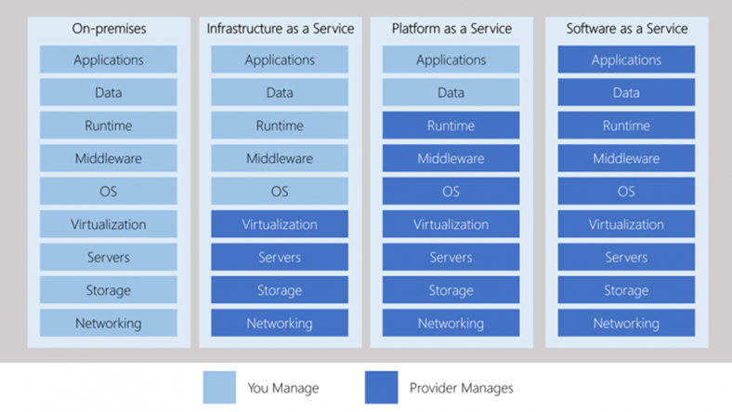
Azure Containers: Day 04
Introduction to Docker Containers
Different Services Like On-Premises, IaaS, PaaS, SaaS
Features of Docker
Architecture of Docker: Client Server Architecture
Azure Container Services
Open Source
Easy, Lightweight
Secure
Service oriented architecture
Reduction in size
Scalable
Fast & Efficient
Segregation of duties
Image & Volume Management
Networking
Azure Container Insurances
Azure Container Apps
Azure Kubernetes Services

Slide 41
Azure Containers: Day 04
Introduction to Kubernetes
Features of Kubernetes
Architecture of Kubernetes: client server architecture, master installed on one machine & node on a separate linux machine. Master to manage docker containers across multiple Kubernetes code.
Automatic Scheduling
Self-Healing Capabilities
Automated Rollouts and Rollbacks
Horizontal Rolling & Load Balancing
Resource Utilization
Support for Multiple Clouds & Hybrid Clouds
Extensibility
Community Support

Slide 42
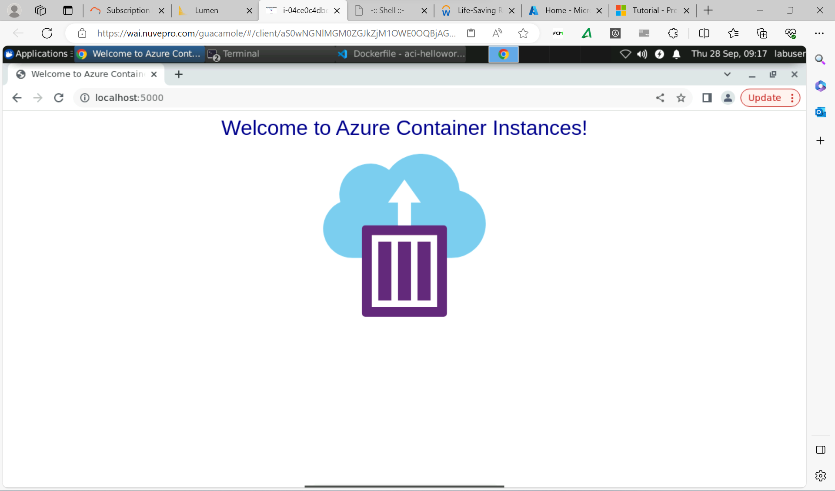
Creation of Docker Image

Slide 43
Azure Deployment/DevOps: Day 05
Introduction to Azure Deployment & DevOps
Agile Methodologies
Github as DevOps Platform
Creation of DevOps Project on Azure
Repository on Azure
Building a Pipeline on Azure DevOps
Introduction to Continuous Integration & Continuous Delivery
Lab Excercise

